Slide 2
Preaching Does Not Profit Some Who Hear It!
Hebrews 4:1-13
Matthew 13:15; 7:26,27

Slide 3
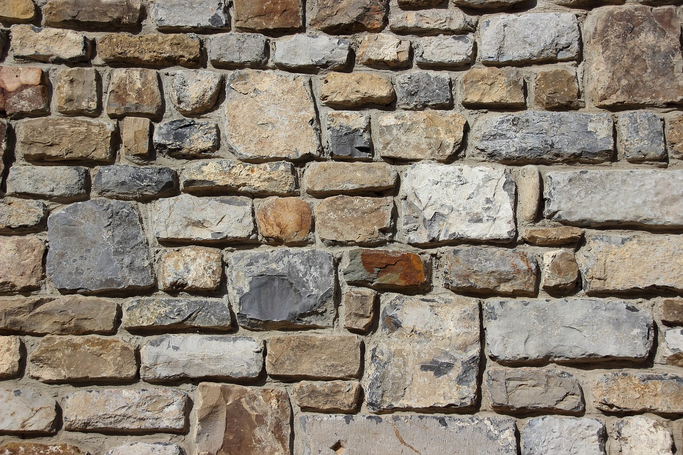
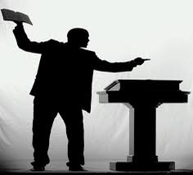
PREACHING TO
THE WALL

Slide 4

IT IS IMPORTANT TO PUT FIRST THINGS FIRST
Matthew 6:33 NKJV 33 "But seek first the kingdom of God and His righteousness, and all these things shall be added to you.”
Luke 14:33 NKJV 33 "So likewise, whoever of you does not forsake all that he has cannot be My disciple.”
Many give little if any heed to such preaching
Continue to let anything and everything come before their service to God

Slide 5
IMPORTANCE OF REGULAR ATTENDANCE
Hebrews 10:25-27 “forsaking the assembling”
James 4:17 “knows to do good- does not do it”
You KNOW when the assemblies are scheduled
And WILFULLY do not attend
You are GUILTY OF SIN!
The WALLS are more faithful in being in the assemblies than they are!

Slide 6
THE NEED FOR FAITHFULNESS
1 Corinthians 15:58 NKJV 58 Therefore, my beloved brethren, be steadfast, immovable, always abounding in the work of the Lord, knowing that your labor is not in vain in the Lord.”
Like a WALL, many will NOT act upon such straightforward admonitions!
Just continue to COAST through life – doing little if anything to be faithful in His service!

Slide 7
WARN ABOUT THE DANGERS OF NEGLIGENCE
Hebrews 2:1 NKJV 1 Therefore we must give the more earnest heed to the things we have heard, lest we drift away.”
Revelation 2:4 “you have left your first love”
Like the WALL, many will not hear and will drift farther and farther away from the Lord until they become completely apostate!

Slide 8
THE NEED FOR GODLINESS
Titus 2:11-12 NKJV 11 For the grace of God that brings salvation has appeared to all men, 12 teaching us that, denying ungodliness and worldly lusts, we should live soberly, righteously, and godly in the present age,”
1 John 2:15-17 - Passing nature of the world
James 4:4 “ friendship with the world is enmity with God”
Bounce off some people like my voice off the wall

Slide 9
THE NEED TO GIVE
1 Corinthians 16:1,2 “that there be no collections when I come”
2 Corinthians 8:7,8 - Love to be shown in their abundance of giving
2 Corinthians 9:6-8 “each one {give} as he purposes in his heart, not grudgingly or of necessity”
Some continue to give no more than the wall!

Slide 10
ADMONISHING PEOPLE TO BE DOERS NOT JUST HEARERS
Matthew 7:21 NKJV 21 "Not everyone who says to Me, 'Lord, Lord,' shall enter the kingdom of heaven, but he who does the will of My Father in heaven.
James 1:22-27 NKJV 22 But be doers of the word, and not hearers only, deceiving yourselves. …27 Pure and undefiled religion before God and the Father is this: to visit orphans and widows in their trouble, and to keep oneself unspotted from the world.”
Some stay as stationary as the wall, and do about as much as the wall!

Slide 11
IMPORTANCE OF TEACHING OTHERS
Hebrews 5:12 NKJV 12 For though by this time you ought to be teachers, you need someone to teach you again the first principles of the oracles of God; and you have come to need milk and not solid food.”
Mark 16:15,16 , Matthew 28:18-20 “make disciples of all the nations,” “teaching them to observe all things that I have commanded you”
Some professed Christians are teaching about as much as the wall!

Slide 12
INDIVIDUAL RESPONSIBILITY
Galatians 6:1 NKJV 1 Brethren, if a man is overtaken in any trespass, you who are spiritual restore such a one in a spirit of gentleness, considering yourself lest you also be tempted.”
Romans 14”12 “each of us shall give account of himself to God”
If we have been no more receptive than the WALL to gospel preaching, WE WILL NOT HAVE A HAPPY ACCOUNTING!

Slide 13
Do You Profit From Preaching?
Hebrews 4:2

Slide 14
Are You Like The Wall?

Slide 15

Does Preaching Profit You!

